Slide 1
Energy and Climate Change
Nick Eyre, Oxford Citizens Assembly, 29th September 2019

Slide 2
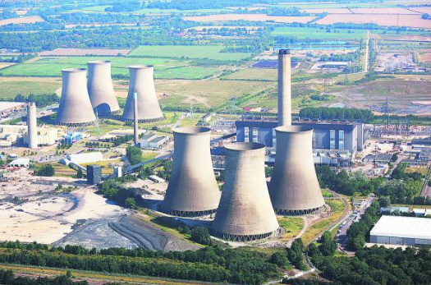
Why does energy matter?
84% of UK greenhouse gas emissions are due to the use of energy
Energy use is critical to many aspects of our lives and prosperity
Energy infrastructure tends to change slowly

Slide 3
Where does our energy come from?

Slide 4
Where does energy get used?

Slide 5
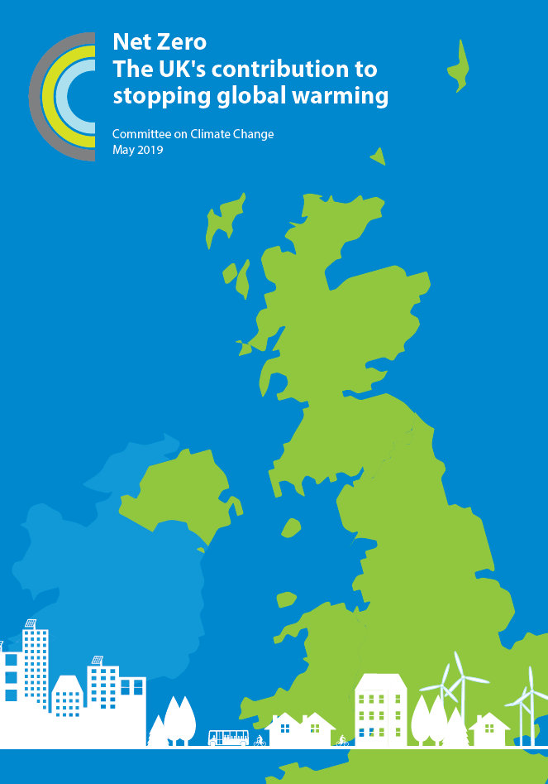
What needs to be done nationally?
The key actions are known:
Big reductions in energy demand,
Conversion of electricity generation to renewable energy,
Rapid adoption of electric vehicles and sustainable transport modes,
Elimination of fossil fuels in buildings and industry.
If we do all of these, by 2050, we can:
halve energy demand, and
supply the rest of our energy from renewables.

Slide 6
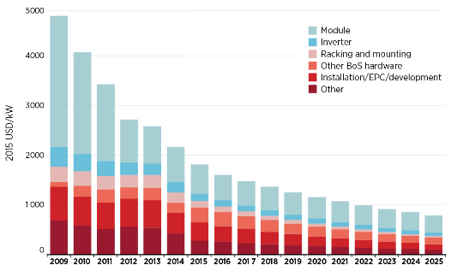
It’s a lot of change, but it’s realistic to be optimistic
Huge opportunities for improved efficiency in energy use,
Changes in lifestyle that reduce energy use, e.g. car use, meat consumption
Renewables now are the cheapest source of electricity
Costs of solar panels, IRENA, 2016
Achieving these will require action by all of:
National Government to set a policy framework,
Local government, and
All of us – as individuals and businesses

Slide 7
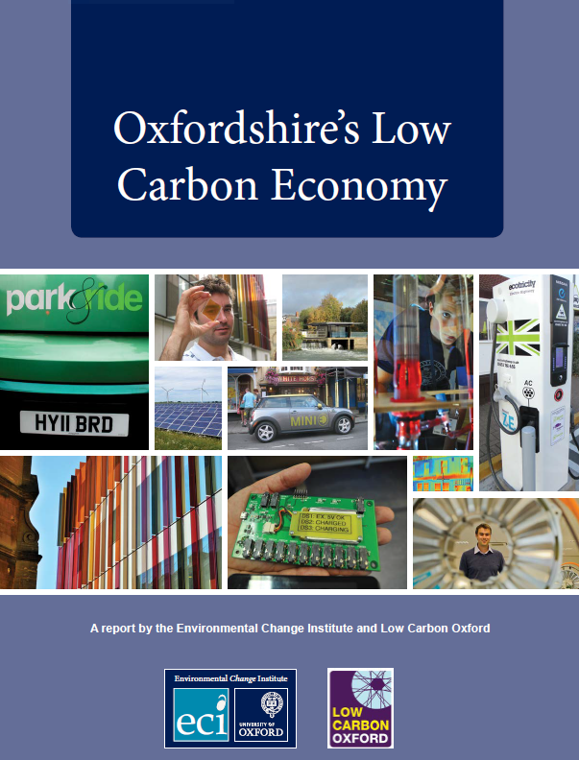
What does this imply locally?
Our calculations for 2030 imply:
Zero carbon new buildings and 4000 major renovations annually.
Growth of public transport and cycling. Most new vehicles low carbon
Electricity: 30-fold increase in renewable electricity generation.
Clean local energy is a big economic opportunity, as energy is currently a £1 billion cost to the Oxfordshire economy.

Slide 8
How do we transform our energy system to ensure it comes from renewable energy?
Solar energy is the best local resource for electricity, with some wind and biomass
Half of the solar potential by 2030 is on roofs, half in fields.
Decarbonising heating is more challenging.
It needs both building efficiency improvement and zero carbon energy supply.
Zero carbon supply could be electricity or ‘green gas’: the choice depends on infrastructure change.

Slide 9
Nick Eyre
Nick.eyre@ouce.ox.ac.uk

Slide 10
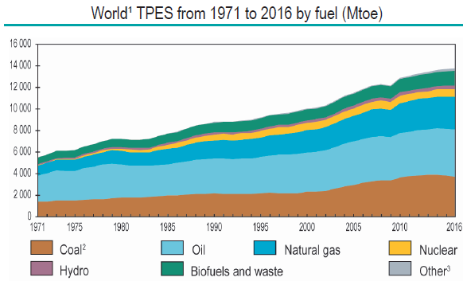
The global energy system is dominated by fossil fuels
IEA World Energy Statistics, 2018

Slide 11
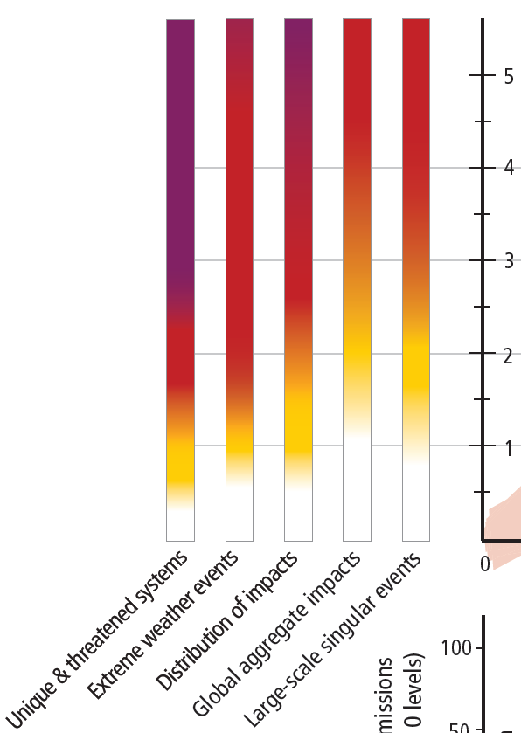
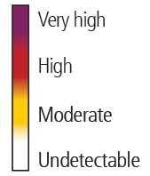
Key impacts of climate change
Impacts of climate change increase as global average temperature rises
Uncertainties remain significant
Current temperature is 1C above pre-industrial levels
There is no obviously ‘correct’ target for temperature rise – lower is better.

Slide 12
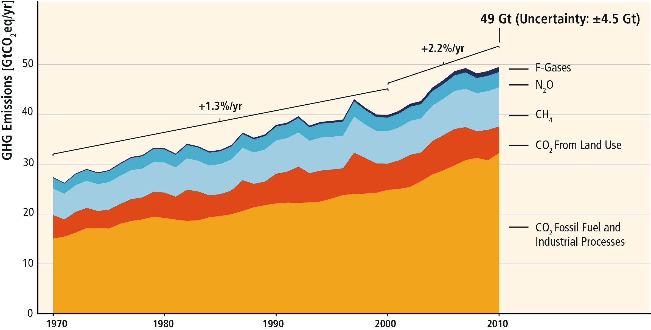
GHG emissions have risen over many decades
Based on Figure 1.3

Slide 13
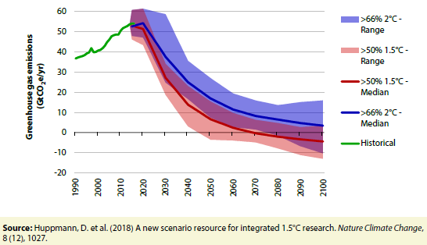
Implications of the Paris Agreement
Emissions of carbon dioxide need to fall to ‘net zero’.
“Limiting warming to 1.5ºC is possible within the laws of chemistry and physics but doing so would require unprecedented changes”.
2ºC looks more feasible but still very challenging
It involves transforming the energy system of the world in a few decades

Slide 14
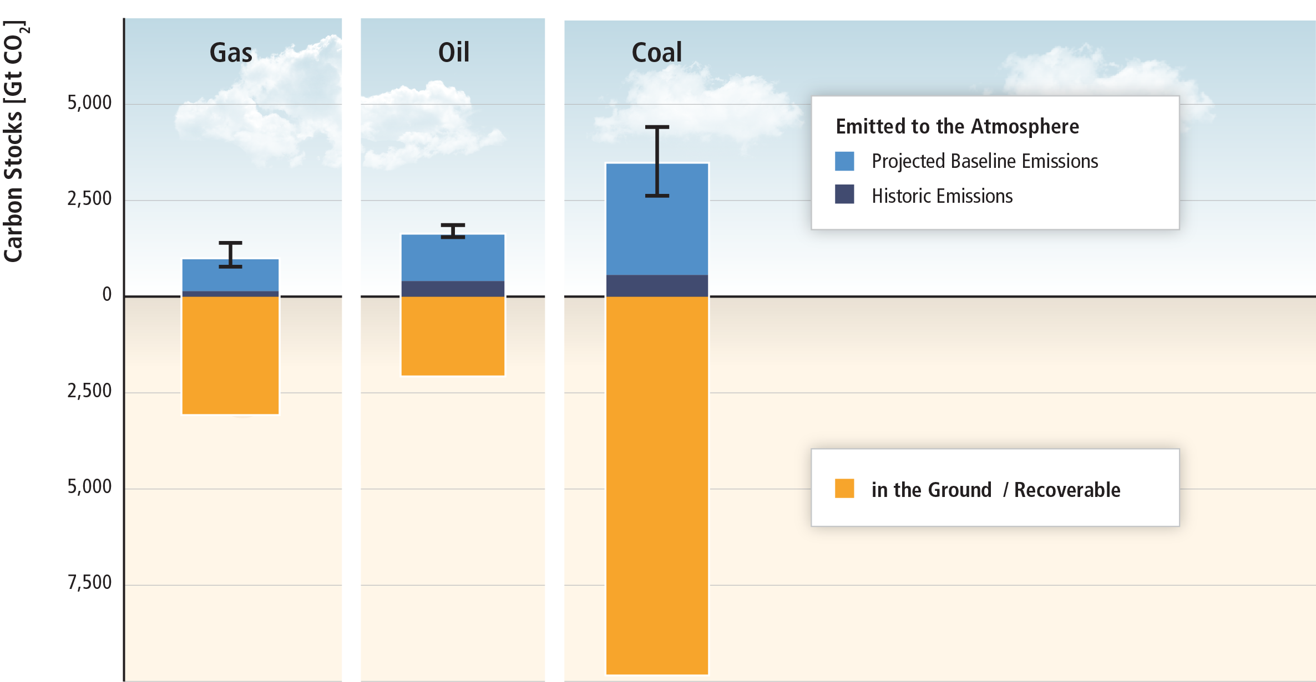
There is far more carbon under the ground than we can safely emit
We need to build a better energy system, using renewables and energy efficiency, so we can keep fossil fuels in the ground.
Based on SRREN Figure 1.7

Slide 15
There are reasons to be cautious
Rising emissions in many countries
Huge unmet need for energy services in developing countries
Many sectors of the economy are difficult sectors to decarbonise, notably aviation, shipping, agriculture, industrial processes, space heating
Some controversial proposed solutions, especially “negative emissions technologies”.

Slide 16
What needs to be done now?
Start with things that already make sense
Zero carbon new buildings
Insulate our buildings
Wind and solar production
Stop expanding fossil fuel production
Action plans for more difficult problems
Support for more sustainable consumption – less aviation, change diet, reuse and recycle etc
Low carbon heating
Technology innovation for industrial processes, freight transport.
Recognise the benefits for health and employment

