Slide 1
How might climate change affect our lives?
The impacts of climate change and how we respond to them
#TalkingClimate
Tara Clarke, science communicator and training manager

Slide 2
Introduction
Climate change impacts in Oxford
Ways that we will need to think and do things differently
Importance of public engagement around local climate impacts

Slide 3
Introduction
Heavier rainfall across the UK will lead to more frequent localised flooding;
As temperatures increase, severe heatwaves will become more common in Oxford;
A changing climate will also increase our demand for energy in Oxford.

Slide 4
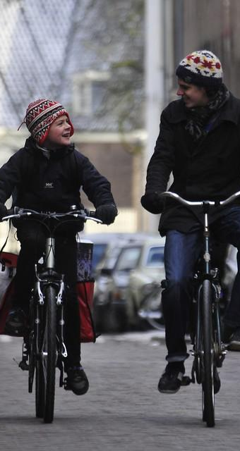
We need to DO things differently
Over half of the cuts required to reach net-zero emissions in the UK require people to do things differently
The way we travel
The way we heat our homes
The food we eat

Slide 5
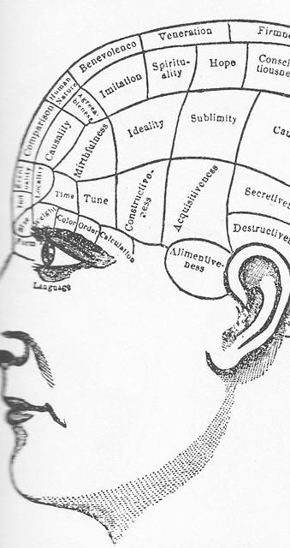
We need to THINK about things differently
Our values (the guiding principles in our lives) and social norms (the unwritten rules about how we behave) matter
Your values shape how you engage with and respond to climate change
Understanding, appreciating and respecting the values of diverse communities in Oxford

Slide 6
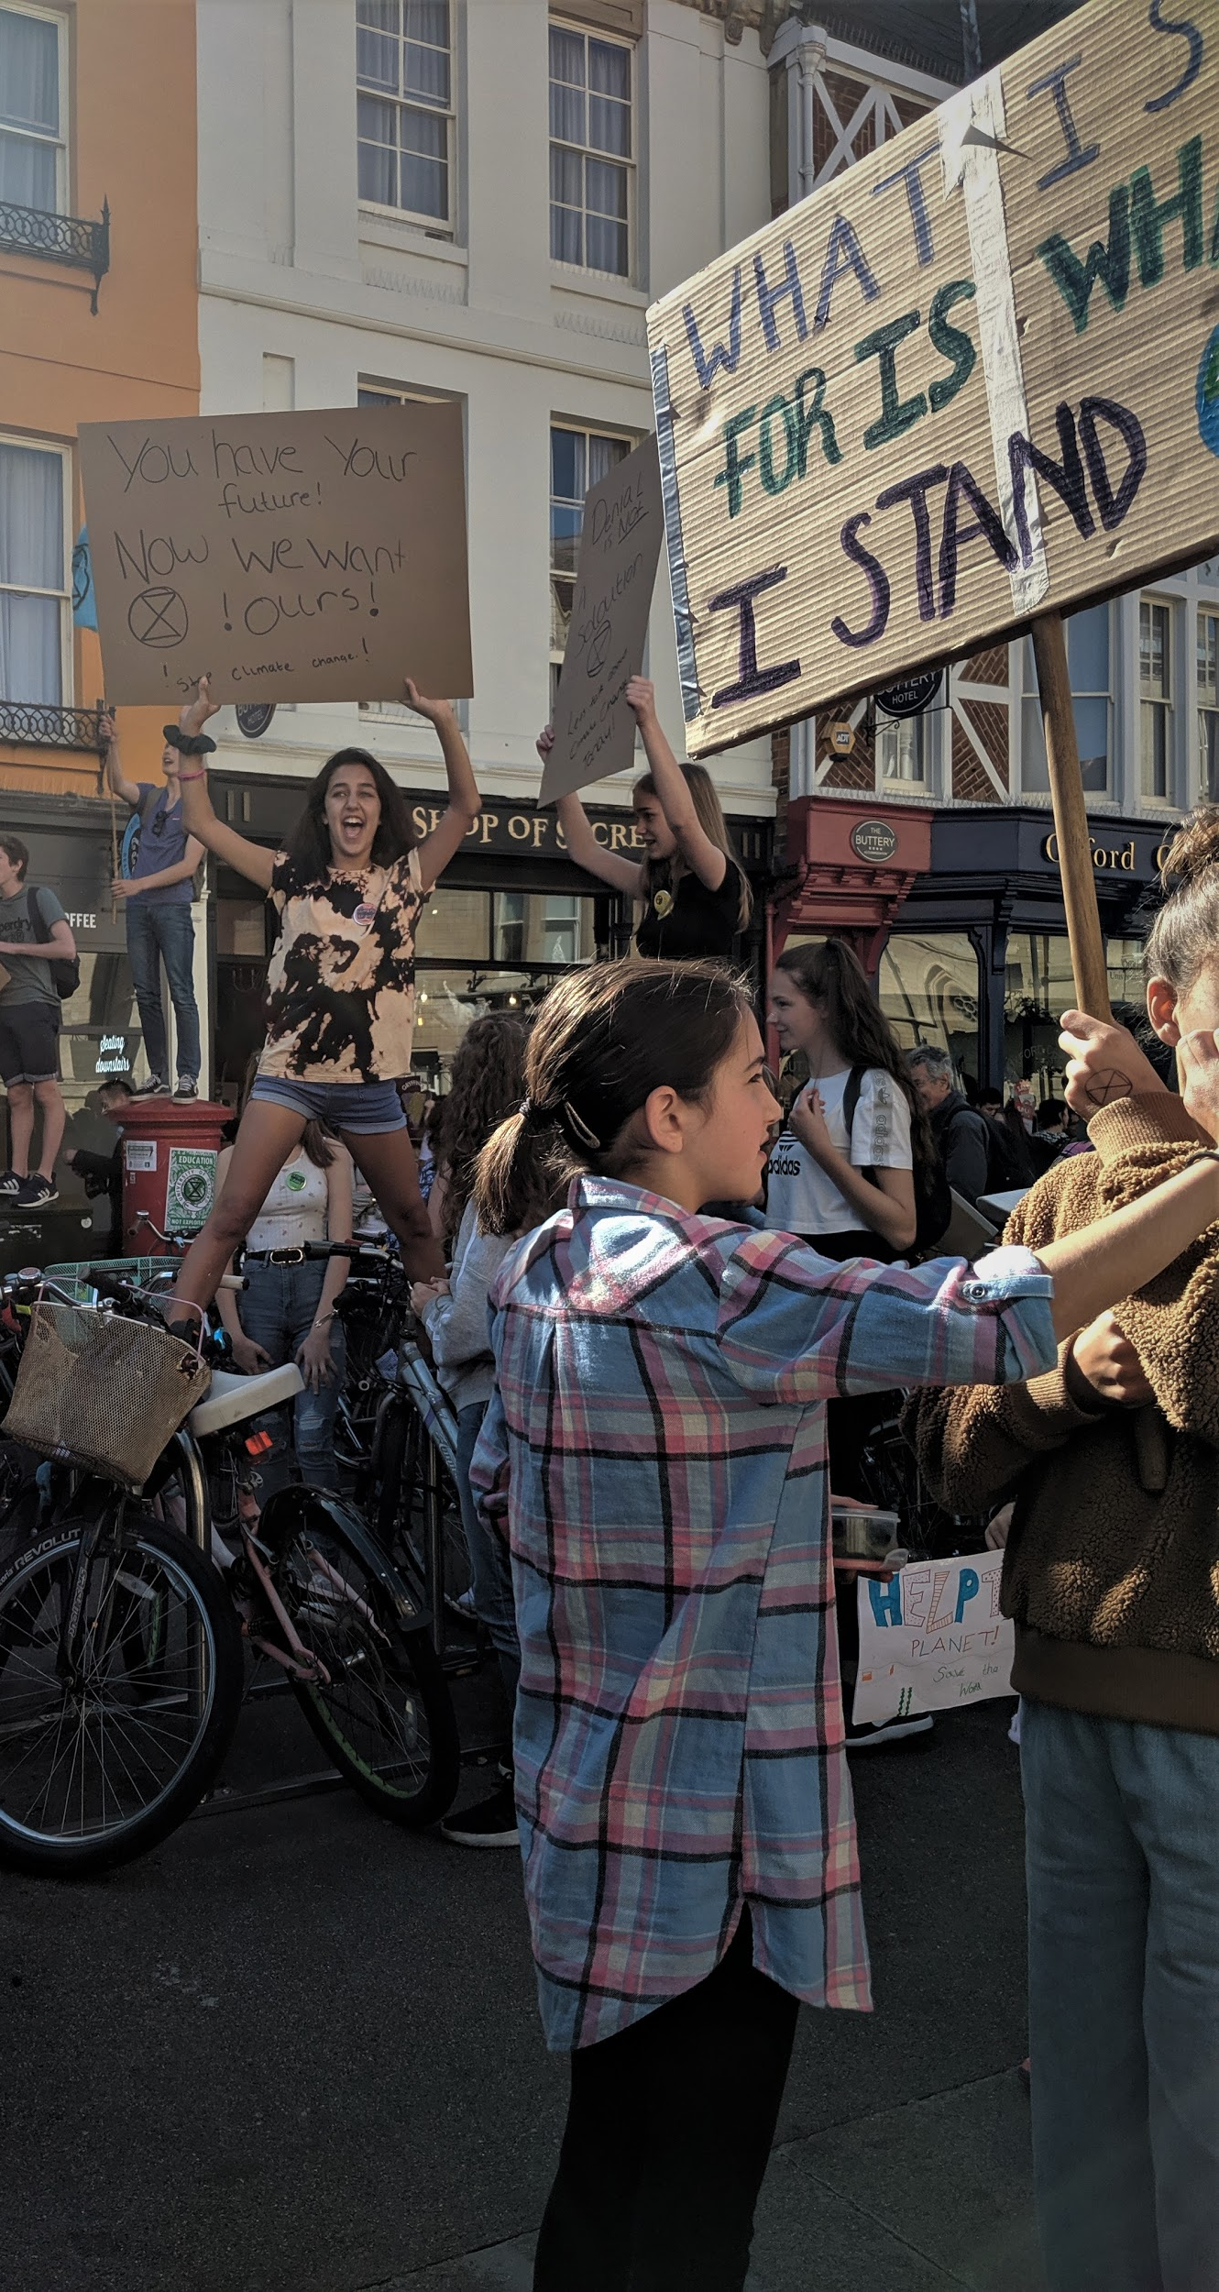
The importance of engagement
To support a shift in the social norm of how we live
Everyone has a right to be properly engaged in climate change & its impacts
Engaging local communities on the role they can play in meeting net-zero emissions in Oxford and supporting communities to adapt.

Slide 7
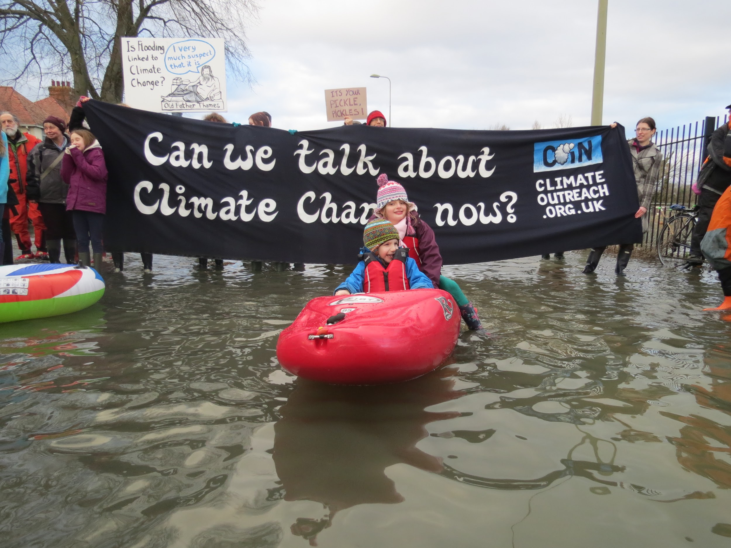
Floods in Oxfordshire, 2014

Slide 8
Further reading
McLoughlin, N, Corner, A., Clarke, J., Whitmarsh, L., Capstick, S. and Nash, N. (2019) Mainstreaming low carbon lifestyles. Oxford: Climate Outreach.
Corner, A. & Clarke, J. (2017). Talking Climate, Palgrave Macmillan.
Climate Outreach. (2019). Scotland’s Climate Change Public Conversations Series - Climate Outreach.

Slide 9
Thank you
Sign up to our monthly newsletter at www.climateoutreach.org
Follow us on social media @ClimateOutreach
Contact us at info@climateoutreach.org
#TalkingClimate

