Slide 1
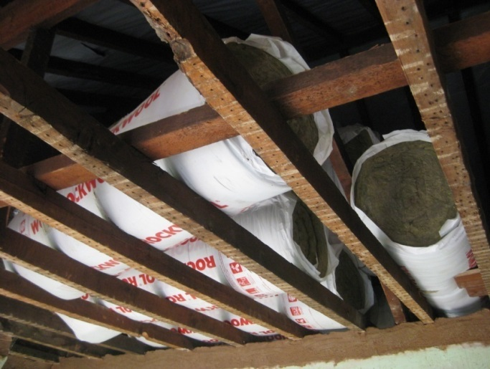
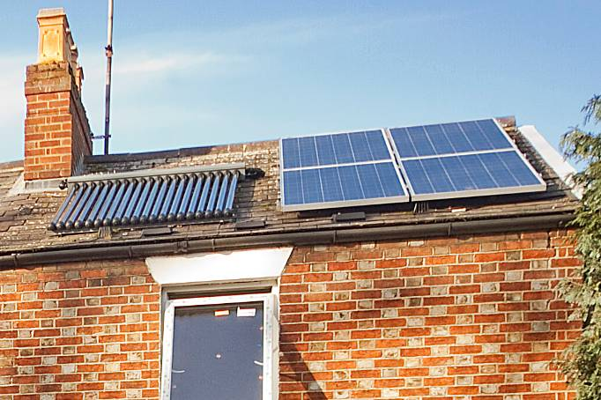
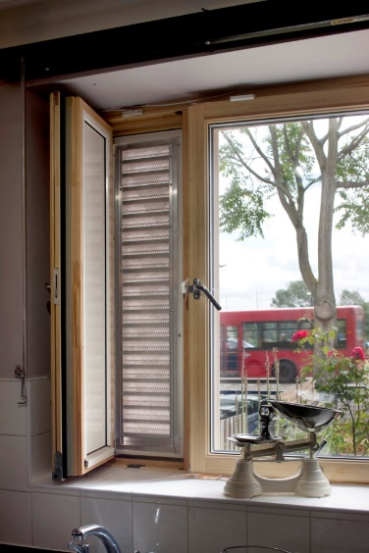
Oxford Citizens Assembly on Climate Change
28 September 2019, Oxford
Buildings panel
Professor Rajat Gupta
Director of Low Carbon Building Research Group, Oxford Brookes University, UK
rgupta@brookes.ac.uk

Slide 2
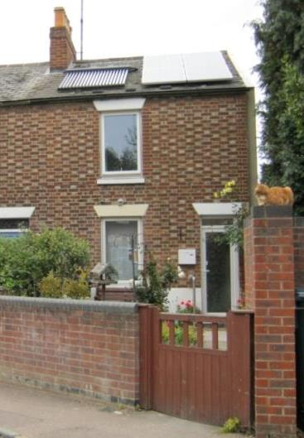
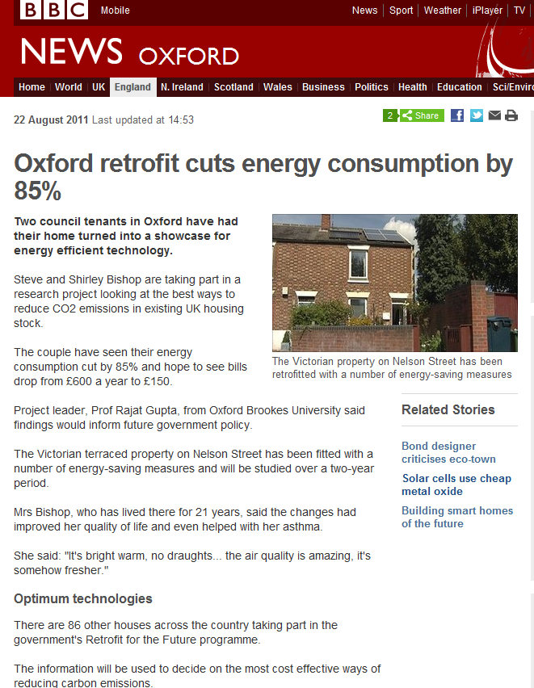
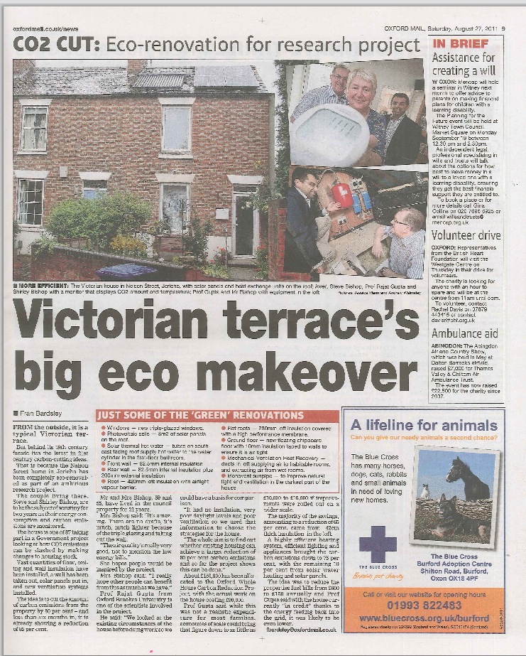
Oxford whole house carbon reduction project

Slide 3
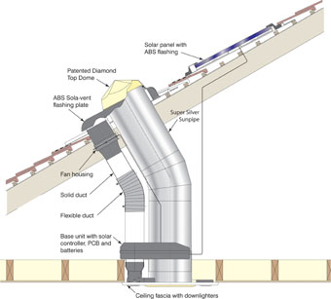
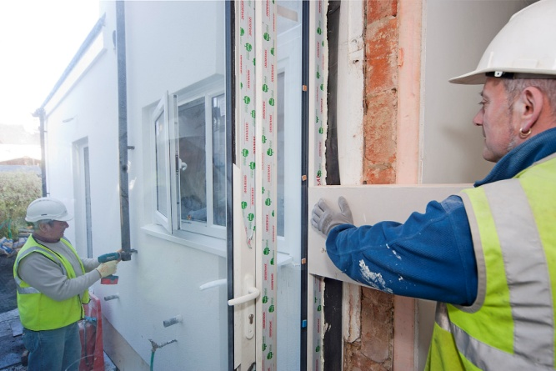
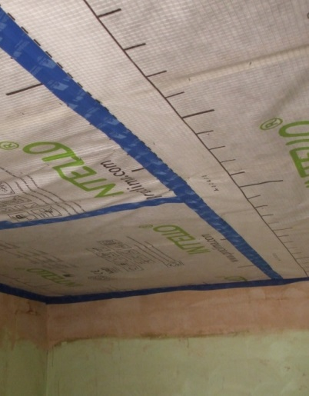
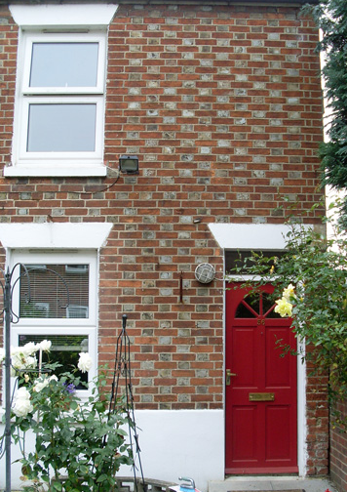
Refurbishment interventions
Insulation (walls & roofs) (U-value: 0.15 and 0.10)
Air tightness: 3m³/h/m² @ 50 Pa
High performance windows
Lighting (natural & artificial)
Mechanical ventilation with heat recovery
Solar (PV & Solar thermal)

Slide 4
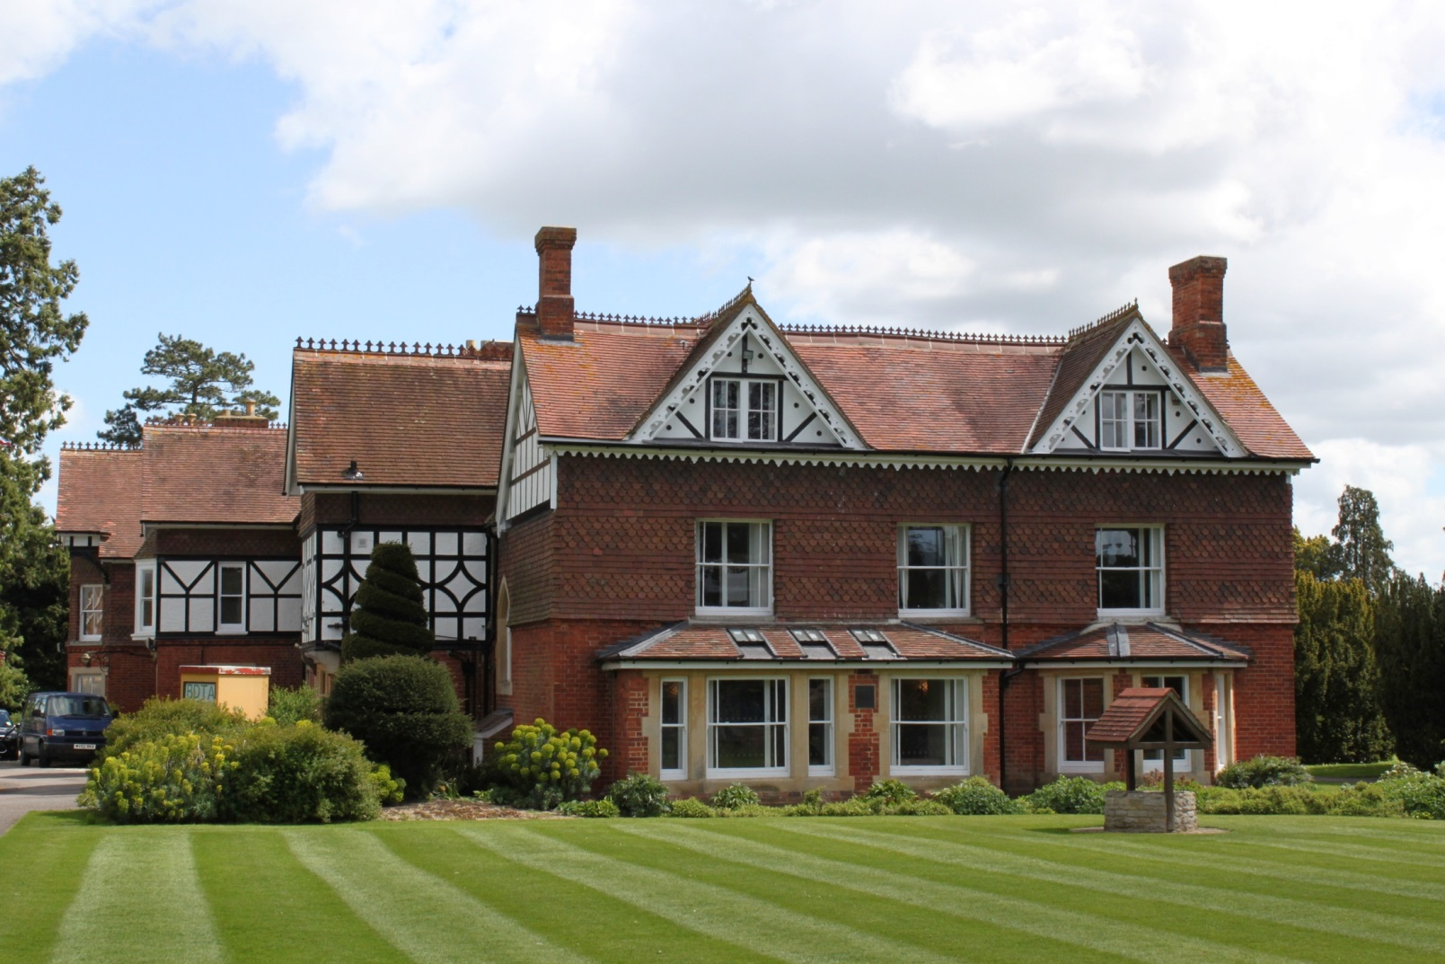
Bicester Town council building: internal insulation, secondary glazing and ventilation strategy

Slide 5
  Actual energy savings (mid-April to mid-Oct14)

Slide 6
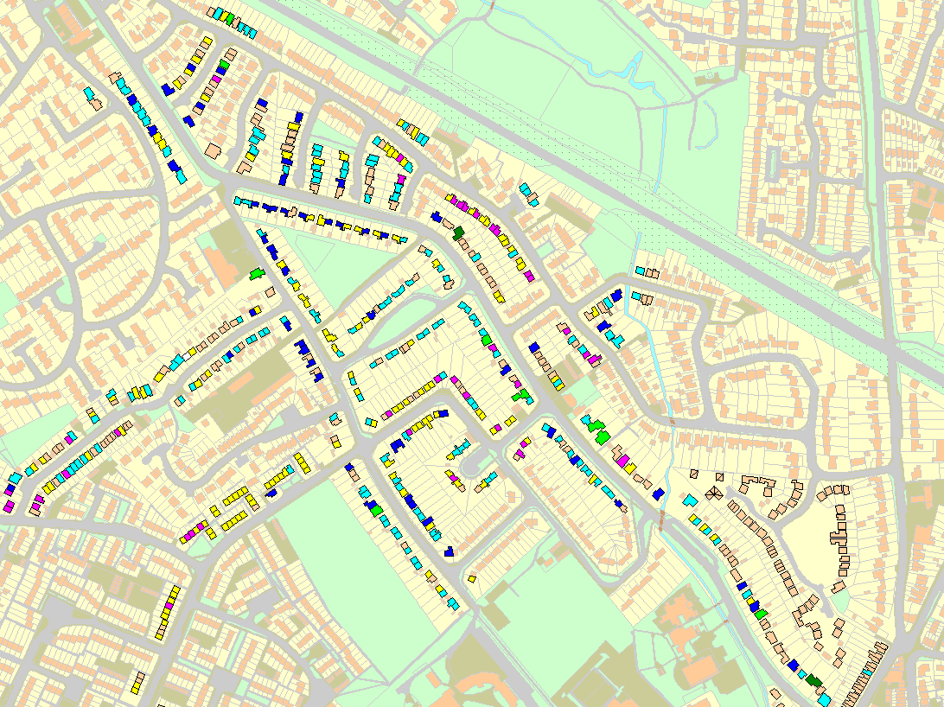
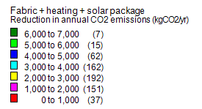
Local energy mapping: Fabric + heating + solar package – reduction in annual CO₂ emissions
© Crown Copyright and Database Right 2016. Ordnance Survey (Digimap Licence)

Slide 7
Construction quality matters otherwise performance gap will occur
Windows
Doors

Slide 8
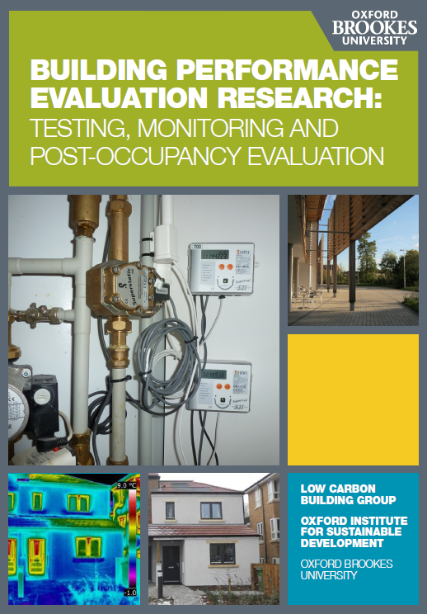
Thank you!
https://www.brookes.ac.uk/uploadedFiles/Faculty_of_Technology,_Design_and_Environment/School_of_Architecture/Site_assets/Documents/lcbg-bpe-booklet-2015.pdf

