Slide 1
Net Zero Jenny Hill

Slide 2
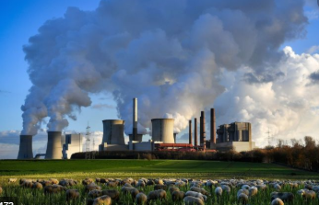
What is net zero

Slide 3
Reaching net-zero emissions in the UK How hard is it?
Energy supply
Energy use
Land
H₂
H₂
H₂
H₂
H₂
H₂
H₂
H₂
H₂
H₂
H₂
CO₂ storage

Slide 4
How hard is it to go faster?
INFRASTRUCTURE
NO MORE NATURAL GAS HEATING
FLY LESS?
LOW-CARBON UK INDUSTRY
HOW MUCH LESS MEAT?
TREES

Slide 5
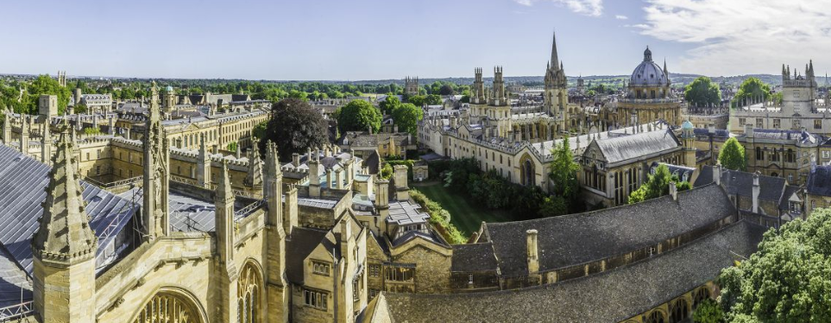
How hard is it for Oxford to go faster?

Slide 6
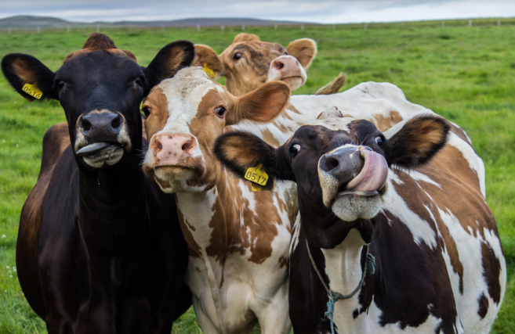
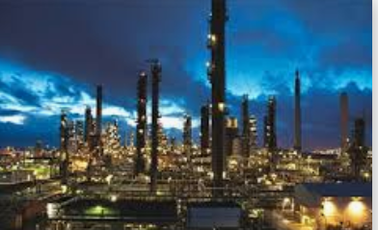
How hard is it for Oxford to go faster?

Slide 7
How hard is it for Oxford to go faster?

Slide 8
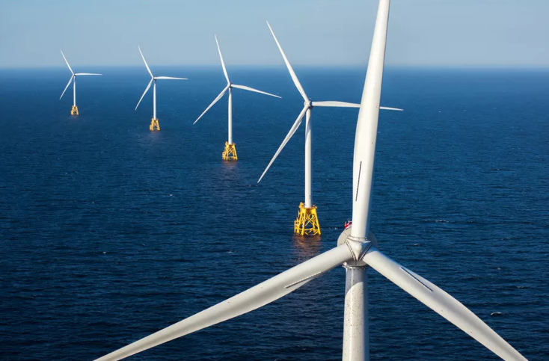
How hard is it for Oxford to go faster?

Slide 9
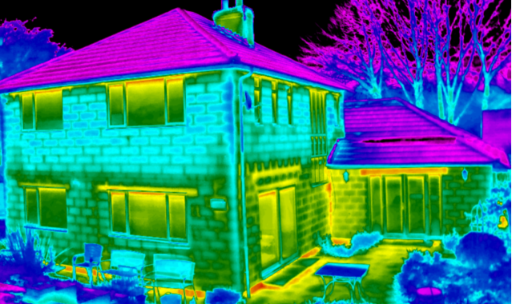
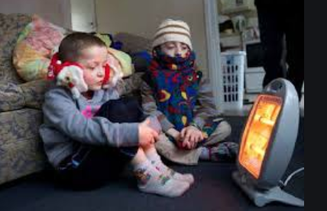
How hard is it for Oxford to go faster?

Slide 10
THANK YOU!
www.theccc.org.uk | @theCCCuk
@Jenny_C_Hill

Slide 11
80% by 2050 to limit temperature rise to 2 degrees C
Global emissions pathways
Source: Huppmann, D. et al. (2018) A new scenario resource for integrated 1.5°C research.

Slide 12
Setting the UK net zero target
Global emissions pathways – the need for net zero
Source: Huppmann, D. et al. (2018) A new scenario resource for integrated 1.5°C research.

Slide 13
Setting the UK net zero target
Global emissions pathways – the need for net zero
Source: Huppmann, D. et al. (2018) A new scenario resource for integrated 1.5°C research.

Slide 14
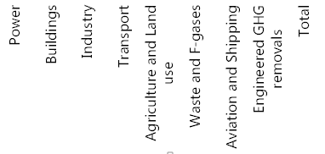
Costs of meeting the UK net-zero target
Central estimates for annual resource cost of meeting a net-zero GHG target (2050)
Source: CCC analysis

