Slide 1

Oxford Citizens Assembly

Slide 2



Notes:
Money that cant be spent on other priorityies
looking after most vulnerable
proviidng housing
Un intended consequences such as if majority of heating is electric and we don’t massively improve stock more expensive – make much worse fuel poverty problem
Multi faceted challenge
Need to rise to the challenge
Also nee to be aware of all the implications and trade offs
Need you help in getting sense of the trade offs that you are willing to make.

Slide 3
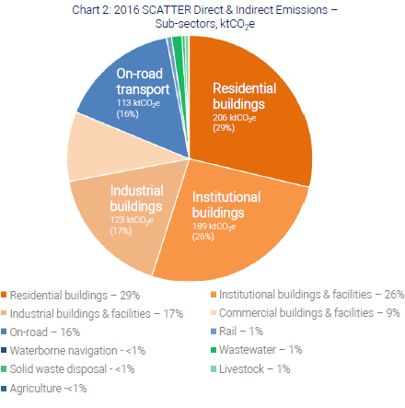
Where do Oxford’s 700,000 tCO₂ emissions originate?

Slide 4
Areas needed to be tackled to drive net Zero Carbon in Oxford with indication of what needs to be achieved to not exceed cities carbon budget
Renewable Energy General | 460% increase in installed solar PV by 2025.
Passenger Transport Shift | By 2035: 100% zero emissions cars and buses By 2025: Complete railway electrification
Commercial Property Appliances | Energy demand for lights & appliances decreases by 30% with 100% electric use
Freight Shift to Low Emissions | Road modal share falls to 50%; greater hybridisation Rail freight is all electric
Electrification of Heating | The proportion of domestic heating systems supplied using electricity is 80-100%
Energy Storage and Demand | 845MW storage 1.27GW interconnection
Domestic Property | 60% of homes insulated, average thermal leakiness reduces 75%
Increase in Recycling | 65% recycling, 10% landfill,25% incineration by 2035, increasing to 85% by 2050

Slide 5
So what has the Council been doing?
  Reduced Carbon Footprint by around 40% over past 5 years
  Reducing demand – energy efficiency, buildings, and vehicles
  Producing own renewable energy
  Purchasing renewable energy

Slide 6
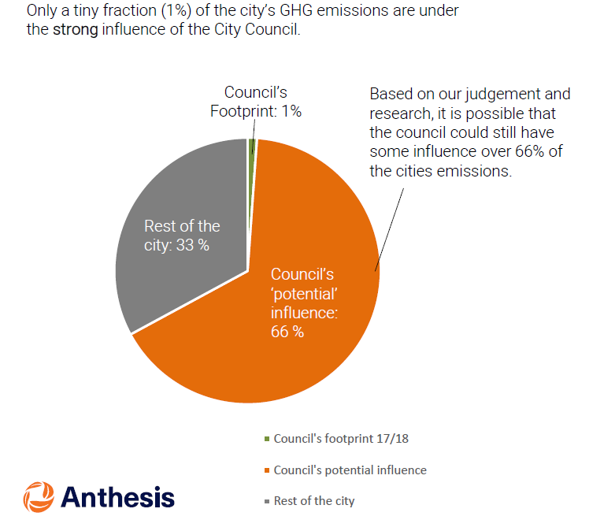

Notes:
Our latest analysis shows that the city is likely to meet or be close to meeting that target
We are now exploring different pathways to net zero.
This means understanding how ambitious we need to be, and which changes will b most impactful, across all economic sectors
We know that some of our current portfolio already look ambitious, but we also know that we’ll need to do a lot more
So the rest of our slidepack introduces the highlights of the current programme to give you flavour of what we’re trying and learning

Slide 7
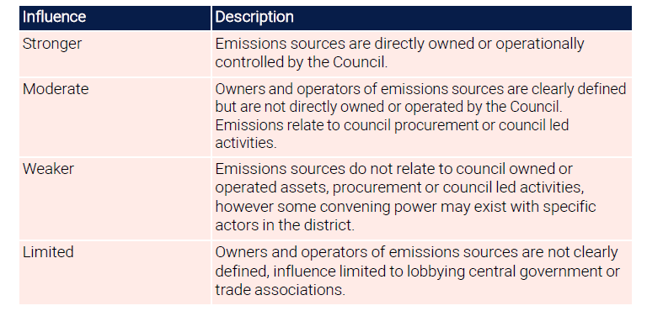
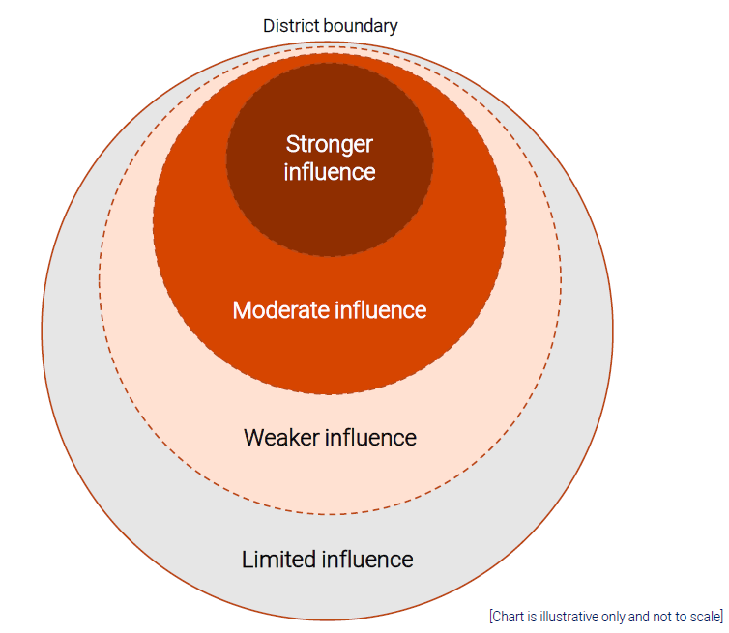

Slide 8
And externally?
Low Carbon Oxford Partnership
Supporting Low Carbon Hub
Supporting and engaging in projects such as
  OxFutures
  Local Energy Oxfordshire
  Energy Superhub Oxford
  Electric vehicle infrastructure
Notes:
So what have we achieved thus far
40 organisations

Slide 9
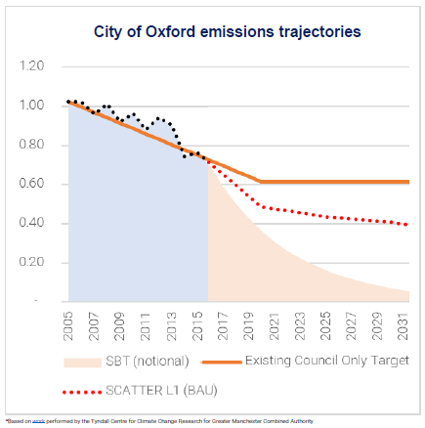
Low Carbon Oxford target 40% reduction by 2020
(2005 baseline)
Notes:
2005 base
Around 10% local initiative
90% national level grid decarbonisation
Where next?
BaU falls way short of our contribution to reduction in CO2 emmissions that unlikley to exceed the 1.5 degree levell
Government says net zero say net zero by 2050
Even if achieve that if we all use up carbon budget before then 1.5 degrees uniobtainable
Should we go faster to ensure that we have made our contribution to helping the climate not overshoot 1.5 – 2 degrees?

Slide 10
What could the Council do next?
Provide leadership – re-invigorated Zero Carbon Oxford Partnership
Implement plan for net zero for council
Support projects and initiatives
Be pro-active
How much will this take from council resources?
Next 5 years -£10m investment £500k p.a running costs

